Slide 1




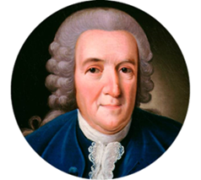
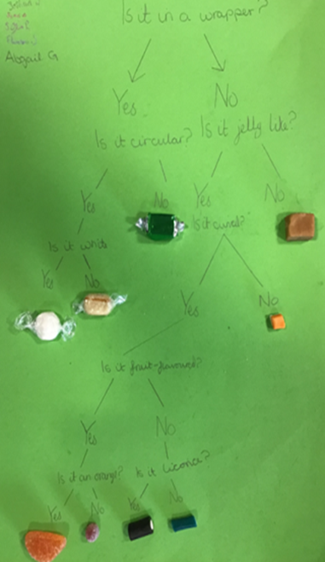

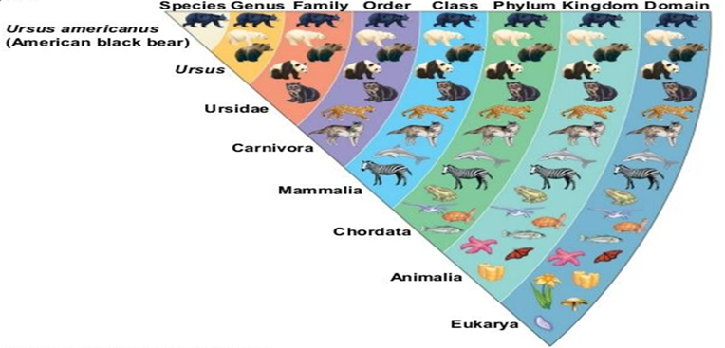
Science Y6 Living Things and Their Habitats
UKS2 Autumn B
Physics | Chemistry | Biology
 | Significant Scientist Carl Linnaeus
Key Knowledge
Living things include things that are alive as well as things that were once-living.
Life processes constitute something as being alive. These can be remembered as MRS GREN: movement, respiration (releasing energy from food using oxygen), sensitivity, growth, reproduction, excretion and nutrition.
A habitat contains all of the things a living thing needs to survive: food, water, shelter and enough space to grow and find enough food.
We can group and classify organisms by their characteristics (identifying features).
We can group them using a classification key, using a series of decisive yes/no questions to rule them in or out of having a characteristic until they are classified within the narrowest definition of an organism (i.e. its species).
Carl Linnaeus expanded the binomial system of classification (using the genus & specific names of organisms) of earlier botanists, to create an orderly methodology still used today.
Some microorganisms are bad for us but we need others to live (digestive system, etc).
Microorganisms can be Bacteria, Archaea or fungi; animals, fungi & plants belong to the Eukaryota domain. Viruses are not living
Vocabulary | Definition
taxonomy | The branch of science concerned with classification, especially of organisms.
organism | Any living animal, plant, or single-celled life form.
microorganism | Microscopic organisms including bacteria, fungi and viruses. These include single-celled, spore-producing organisms as well as those in colonies.
vertebrates | Animals with a backbone. There are five classes: mammals, amphibians, reptiles, fish & birds.
invertebrates | Animals without backbones. They can be soft-bodied (worms, slugs, jellyfish) or have exoskeletons (insects, spiders, crustaceans).
binomial | The two-part name of a species of living organism (consisting of the genus followed by the species).
classification key | A series of yes/ no questions about an organism's characteristics drawn as a diagram.
characteristic | An identifying feature of an organism.
botany | The study of plants.

