Slide 1
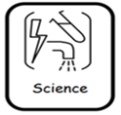
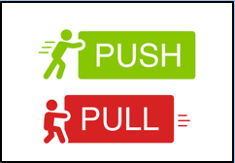
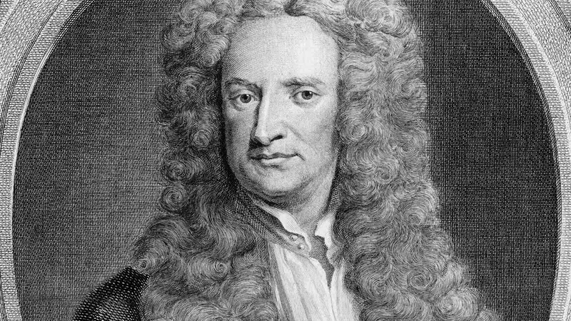
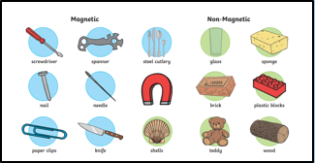
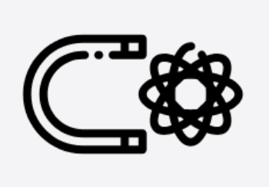


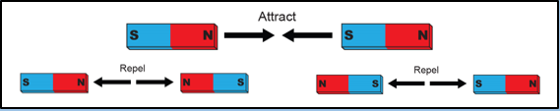
Science Y3 Forces and Magnets
LKS2 Autumn B
Famous Scientist |  | Sir Isaac Newton is a famous 17th-century scientist and mathematician born in Woolsthorpe, Lincolnshire. He is best known for his three Laws of Motion and his ground breaking discovery of gravity inspired by watching an apple fall from a tree.
Isaac Newton
Physics | Chemistry |  | Biology
Key Knowledge
Forces are pushes & pulls. They make objects start moving, speed up, slow down or stop.
When you push down on a surface, the opposite push force is called the reaction force.
Friction is a force resisting movement between two surfaces, slowing down an object.
The material of an object can affect how much friction occurs between surfaces.
A magnet has an invisible area around it (a magnetic field) that pulls in magnetic materials.
The metals iron, nickel & cobalt are magnetic.
If a material is magnetic, it will be attracted to a magnet. If a material is non-magnetic, it will not be attracted to a magnet.
Magnetic forces happen without contact (touching) so can happen at a distance.
The stronger a magnet, the further it can attract magnetic materials.
Poles are the opposite ends of magnets. One end attracts (pulls) and the other repels (pushes) magnetic materials.
Opposites attract so two different poles will pull together but like poles repel each other.
Everyday objects such as computers, fridges, freezers, TVs & compasses all use magnets.
Vocabulary | Definition
forces | Pushes and pulls on an object
pull | Being moved towards something.
push | Being moved away from something.
surface | The outside of something.
resistance | Any force slowing down movement.
friction | A pushing force between two surfaces.
magnet | An object that attracts magnetic materials towards it by an invisible force.
magnetic | Objects attracted to a magnet because they contain iron, nickel or cobalt.
magnetic field | Area around a magnet where the magnetic force will attract magnetic objects.
poles | The two opposite ends of a magnet directing the magnetic field
repel | A force pushing something away.

