Slide 1

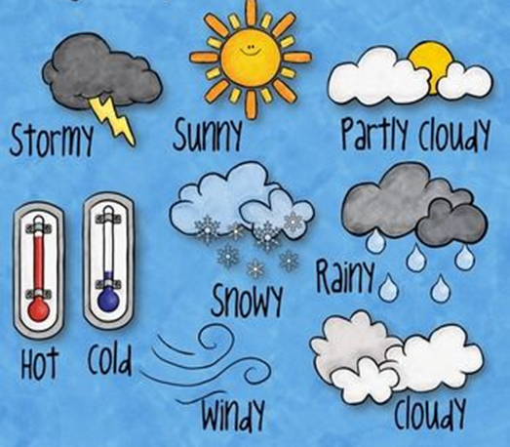



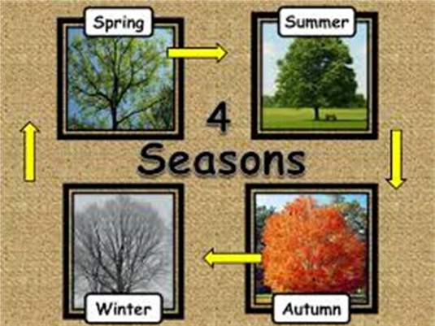
KS1 Autumn A
Science Y1 Seasonal Change
Significant Scientist |  | Liam Dutton is a Welsh meteorologist, broadcaster, and author best known as the weather presenter for Channel 4 News. He previously worked for the BBC and is respected for making complex weather information easy to understand.
Liam Dutton
Physics | Chemistry |  | Biology
seasons | Four different times during the year with different types of weather: spring, summer, autumn and winter. | day | There are 7 days in a week.
weather | Weather is what the sky and the air outside are like: such as cold, cloudy, wet, snowy, hot, sunny and which way the wind blows and how strong it is. | month | There are 12 months in a year.
daylight | The amount of light during the day, which changes with the seasons.
Key Knowledge
The weather changes throughout the year. It is hotter in summer and colder in winter.
There are four seasons in the year – spring, summer, autumn and winter.
There are 7 days in a week.
There are 12 months in a year.
Daylight hours change throughout the year: there is more light during the day in summer and less in winter.
In autumn, the leaves on trees turn red, yellow, orange and brown because they lose their green colour.
In winter, some trees lose their leaves completely.
We need to wear a coat when it is cold, raining or snowing.
We need to wear a hat, sunglasses and sun cream when it is hot or sunny.

