Slide 1


Welcome to the Daffodils Class

Slide 2

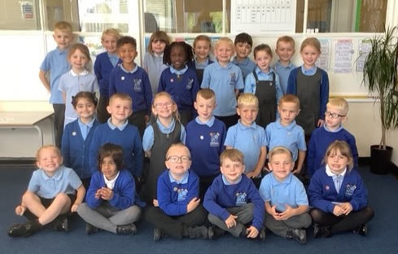
Daffodils Class

Slide 3
School rules
Keep hands, feet and objects to ourselves
Use quiet calm voices
Always follow teacher instructions
Care for the school environment

Slide 4
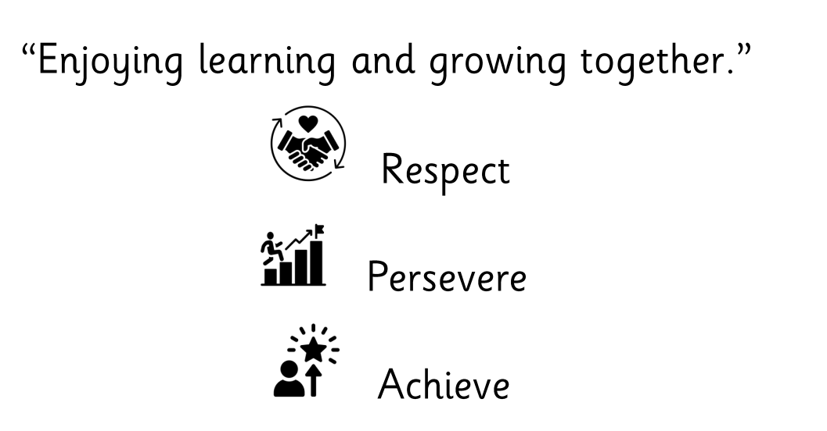
Draft vision and values

Slide 5
Attendance and punctuality
School begins at 8.45am for all children
Breakfast clubs runs from 7.30am if needed
Children should be at school every day and on time
Good attendance and punctuality sets good habits for the future

Slide 6
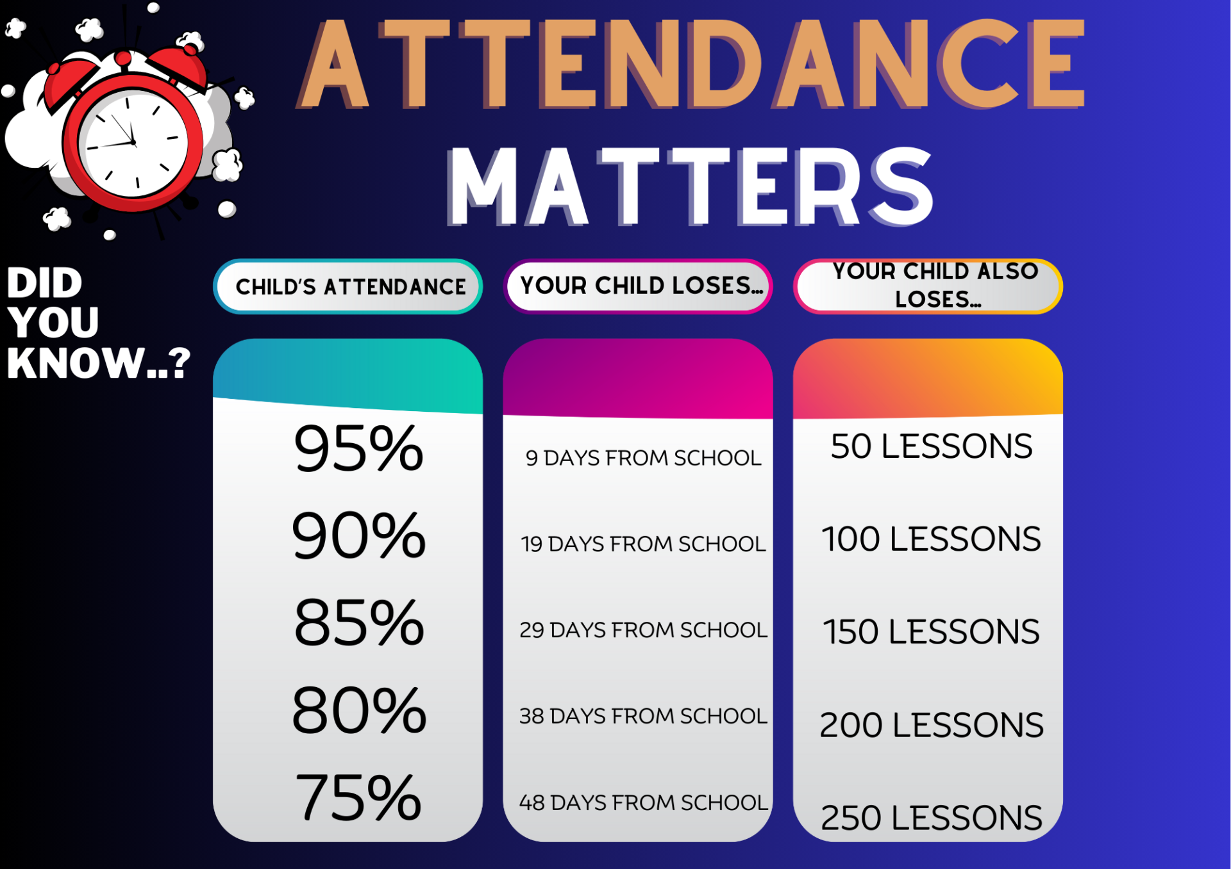

Slide 7
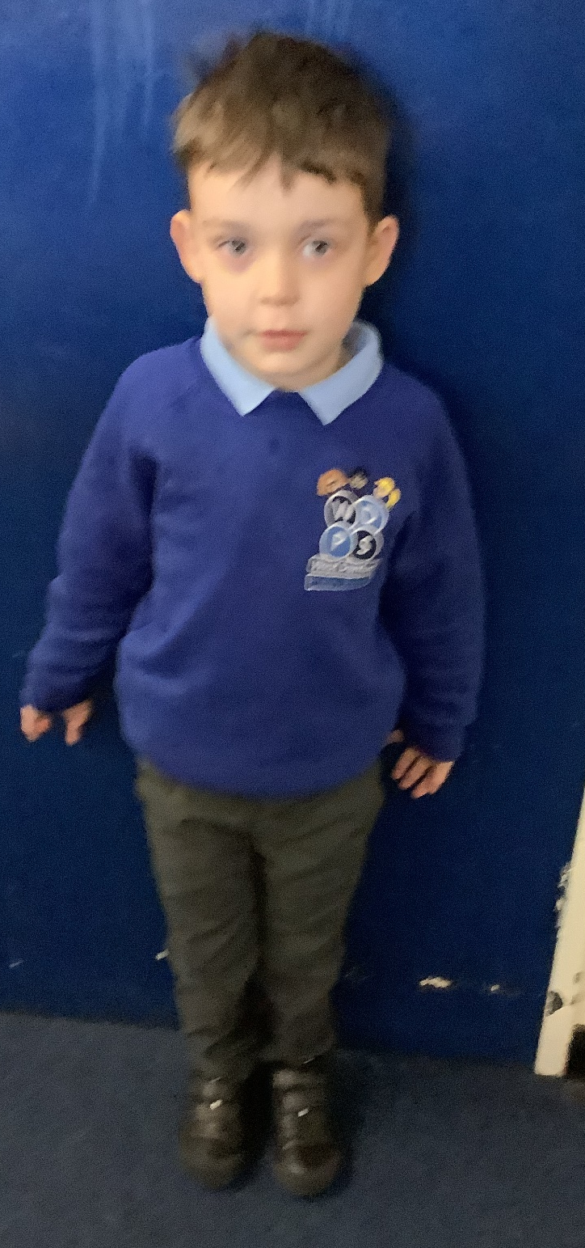
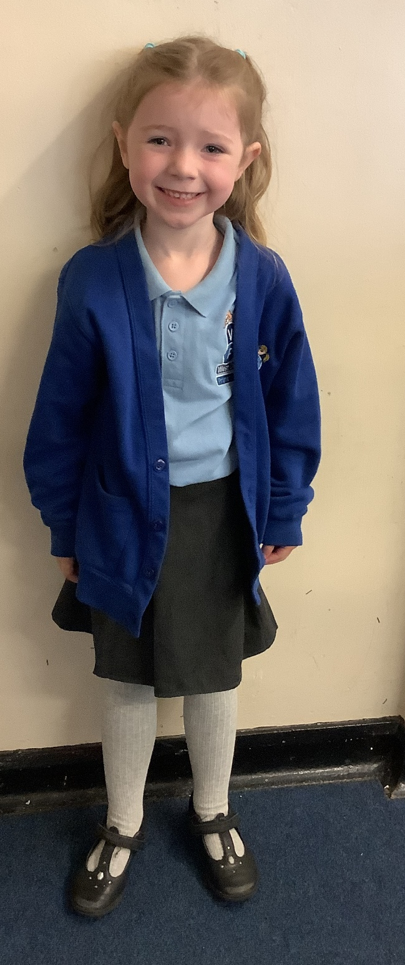
Uniform
Smart uniform sets the tone for a day of learning.
Remember school shoes, stud earrings (if pierced)and smart hairstyles.

Slide 8
PE – Physical education
PE is part of the National Curriculum.
Our PE days are Tuesday and Thursday
Children are to come in their PE tops or school T-shirt for the day.
Children can wear black tracksuit bottoms/leggings and school jumpers if it is cold. Usually shorts.
Other clothing is not allowed.

Slide 9



#WDPSYearofReading
WE ARE A READING SCHOOL!
Our ambition is for every child to read by 7 using a synthetic phonics approach and to develop a love of reading for fluency and comprehension in order to access a broad and balanced curriculum. We do everything to make this happen.

Slide 10
RWInc – our method to teach phonics
Reading
When using RWI to read the children will:
Learn 44 sounds and the corresponding letter/letter groups using simple prompts
Learn to read words using sound blending (Fred talk)
Read lively stories featuring words they have learnt to sound out
Show that they comprehend the stories by answering 'Find It' and 'Prove It’
Miss Knowles is our phonics leader.
Children will read every day in school and we expect them to read every day at home.

Slide 11
Accelerated reader – a love of reading- usually Year 2 onwards
What is Accelerated Reader?
Accelerated Reader is a computer program that helps teachers manage and monitor children’s independent reading practice. Your child picks a book at their own level and reads it at their own pace. When finished, your child takes a short quiz on the computer. (Passing the quiz is an indication that your child understood what was read.)
Accelerated Reader gives children and teachers feedback based on the quiz results, which the teacher then uses to help your child set goals and direct ongoing reading practice

Slide 12
Homework/Reading
Homework in KS1 consists of:
  Daily reading
  Daily spelling
  .

Slide 13
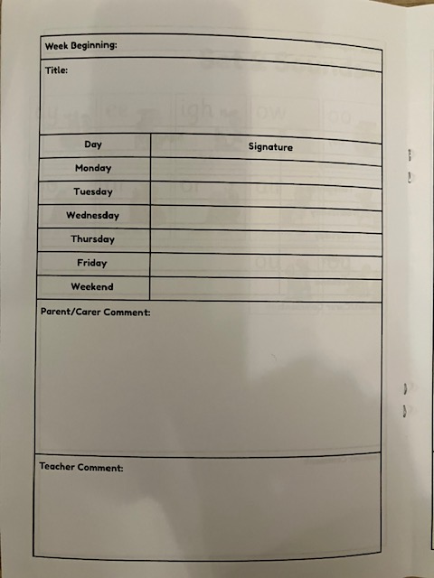
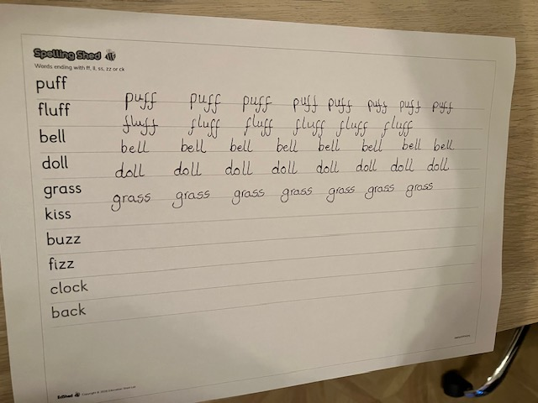
Reading diary
Spellings

Slide 14
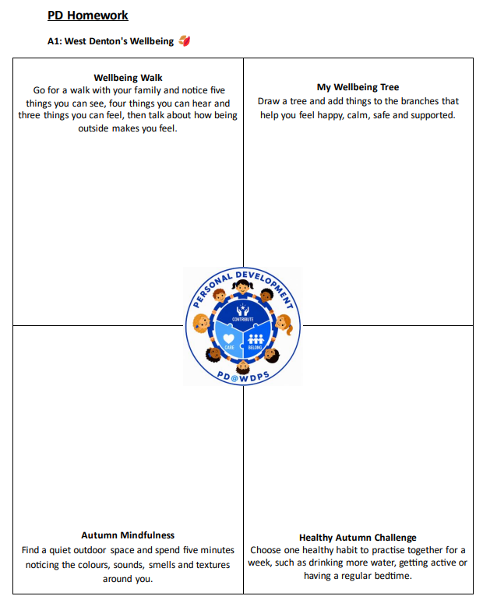

Slide 15
Everyday
Water bottle
Reading folder with your reading book and diary in.
Correct uniform
Please don’t send any toys, squishies, lip glosses, hand gel etc into school.

Slide 16
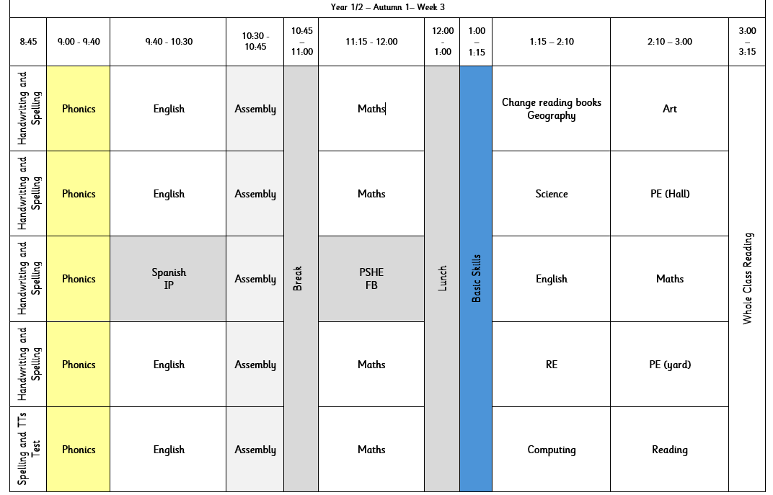
Timetable

Slide 17
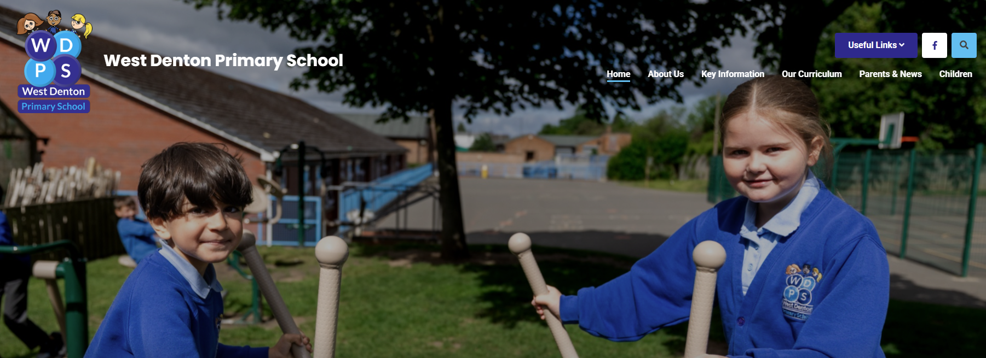
How to find out more
Our school website: New website ready to launch VERY soon!

Slide 18

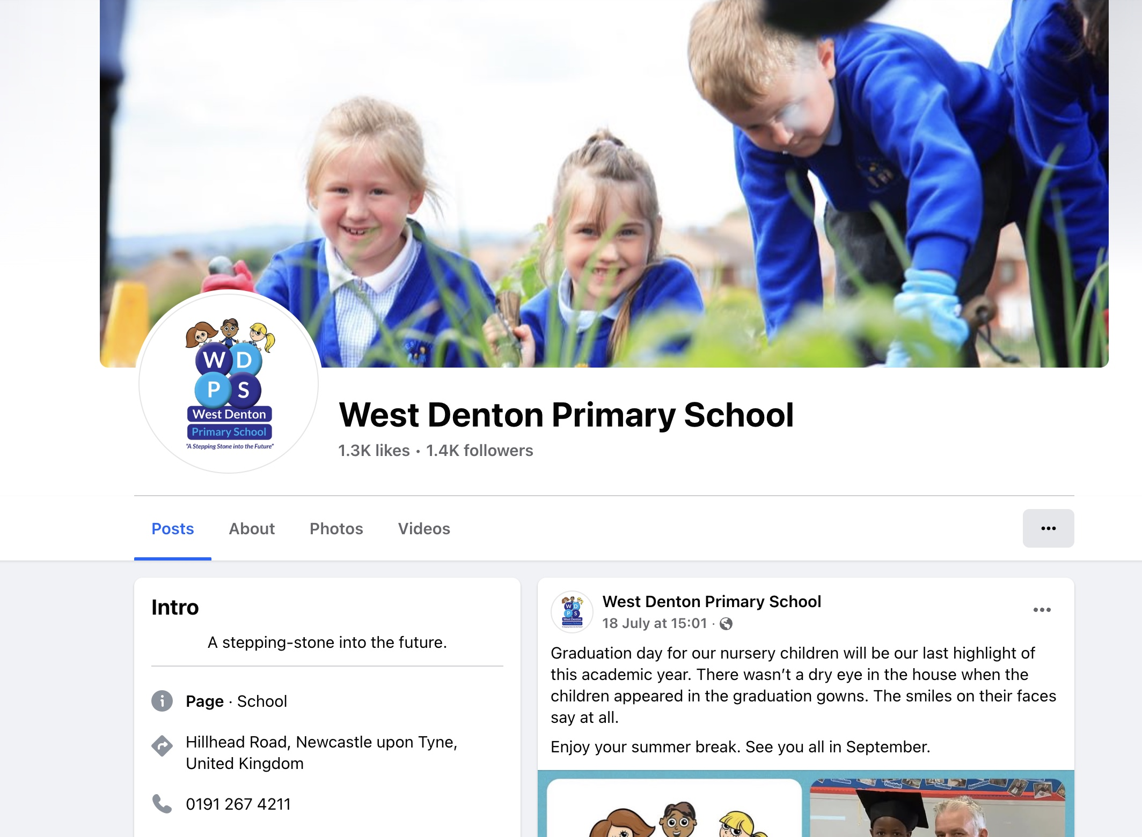
https://www.facebook.com/westdentonprimaryschool/

Slide 19
If you need to talk to us…
We can pass on small pieces of information at the beginning of the day.
If you would like to talk more in-depth, please make an appointment with the office. We’re here to listen and address things as soon as possible.

