Slide 1


Welcome to snowdrops

Slide 2
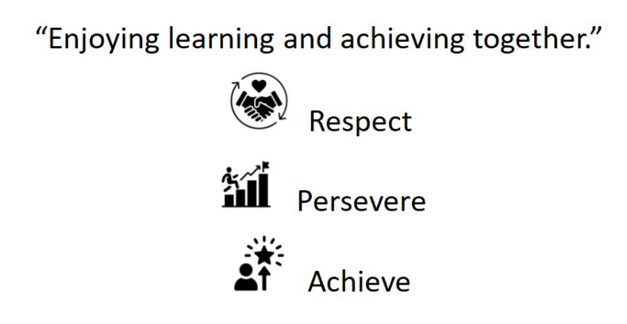
Our vision and Values:

Slide 3
School rules
Keep hands, feet and objects to ourselves
Use quiet calm voices
Always follow teacher instructions
Care for the school environment

Slide 4
Attendance and punctuality
School begins at 8.45am for all children
Breakfast clubs runs from 7.30am if needed
Children should be at school every day and on time
Good attendance and punctuality sets good habits for the future

Slide 5
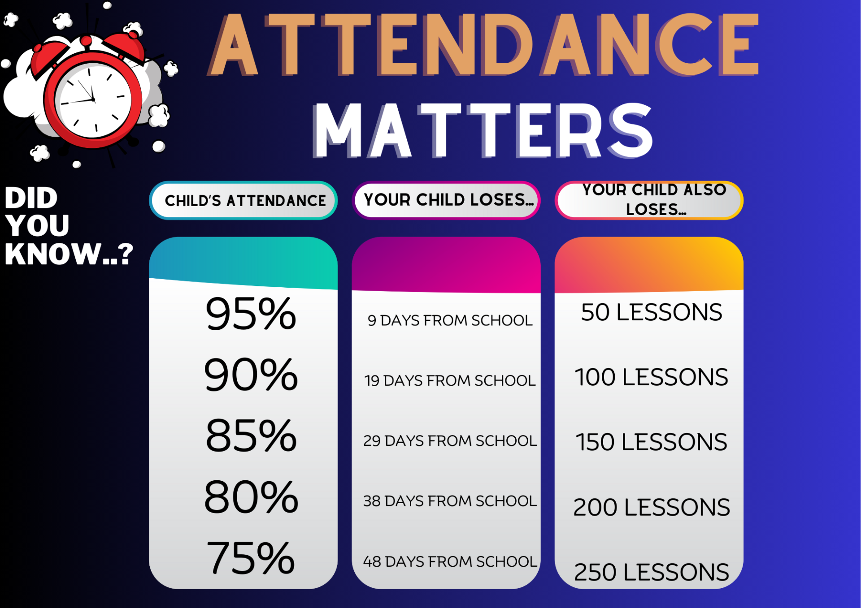

Slide 6
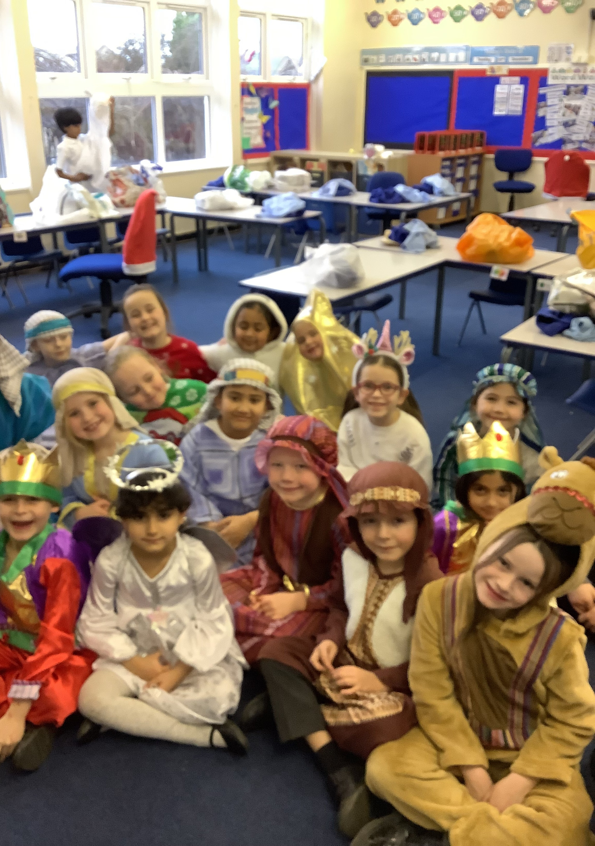
Uniform
Smart uniform sets the tone for a day of learning.
Remember school shoes, stud earrings (if pierced)and smart hairstyles.
No squishies - health and safety

Slide 7
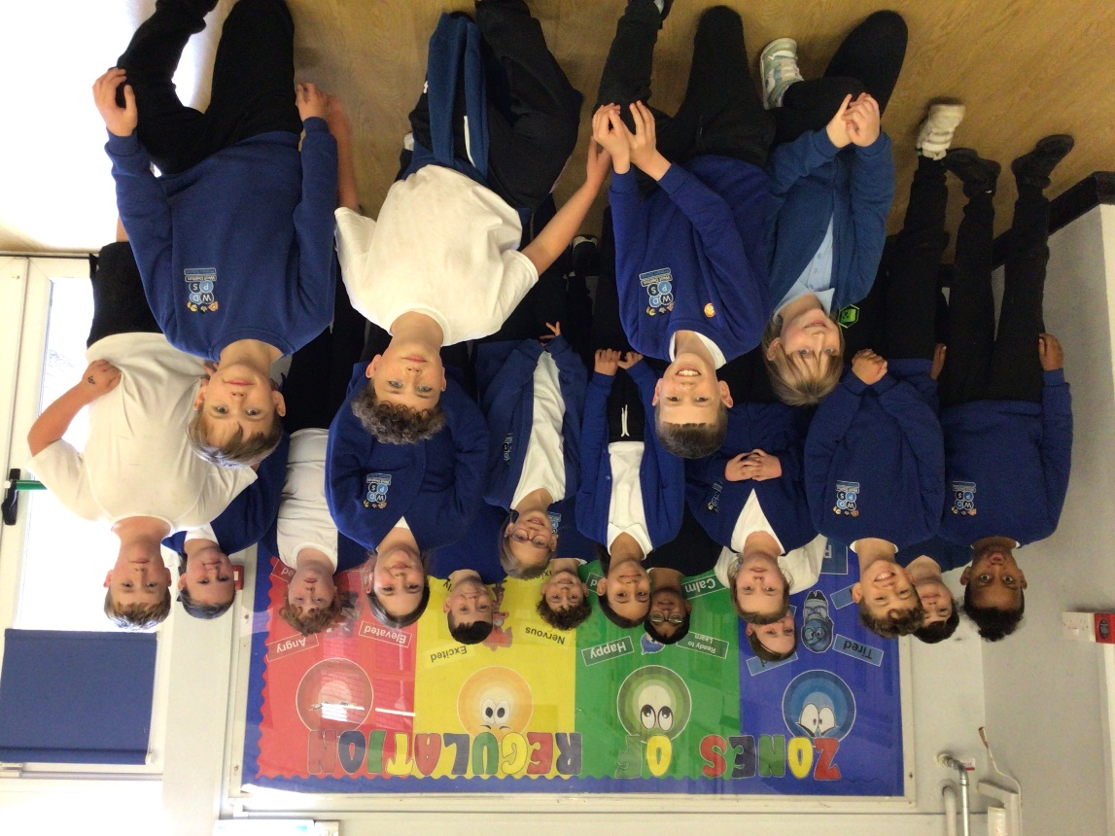
PE – Physical education
PE is part of the National Curriculum.
Our PE days are Thursday and Friday
Children are to come in their plain white PE tops or school polo-shirt for the day.
Children can wear plain black tracksuit bottoms/ leggings and school jumpers if it is cold. Usually shorts. Trainers must be worn.
Other clothing is not allowed.

Slide 8



#WDPSYearofReading
WE ARE A READING SCHOOL!
Our ambition is for every child to read by 7 using a synthetic phonics approach and to develop a love of reading for fluency and comprehension in order to access a broad and balanced curriculum. We do everything to make this happen.

Slide 9
RWInc – our method to teach phonics
Reading
When using RWI to read the children will:
Learn 44 sounds and the corresponding letter/letter groups using simple prompts
Learn to read words using sound blending (Fred talk)
Read lively stories featuring words they have learnt to sound out
Show that they comprehend the stories by answering 'Find It' and 'Prove It’
Miss Knowles is our phonics leader.
Children will read every day in school and we expect them to read every day at home.

Slide 10
Accelerated reader – a love of reading
What is Accelerated Reader?
Accelerated Reader is a computer program that helps teachers manage and monitor children’s independent reading practice. Your child picks a book at their own level and reads it at their own pace. When finished, your child takes a short quiz on the computer. (Passing the quiz is an indication that your child understood what was read.)
Accelerated Reader gives children and teachers feedback based on the quiz results, which the teacher then uses to help your child set goals and direct ongoing reading practice

Slide 11
homework
Homework in Lower KS2 consists of:
  Daily reading
  Spelling
  Times tables
  It is set on a Friday and ‘collected’ on a Friday.
  This sets good habits for moving on in education and the world of work.
  It is tightly focused on core learning – it helps to build perseverance.
  Teachers will keep a record of children who complete homework.

Slide 12
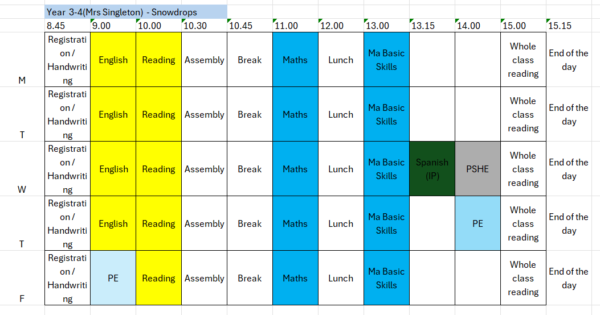
Class Timetable

Slide 13
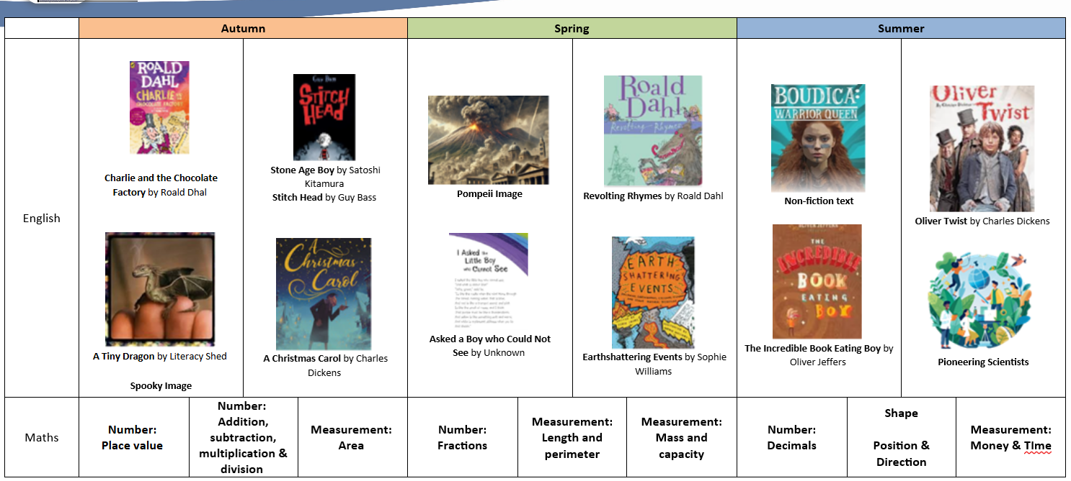
Year 3-4 Curriculum

Slide 14
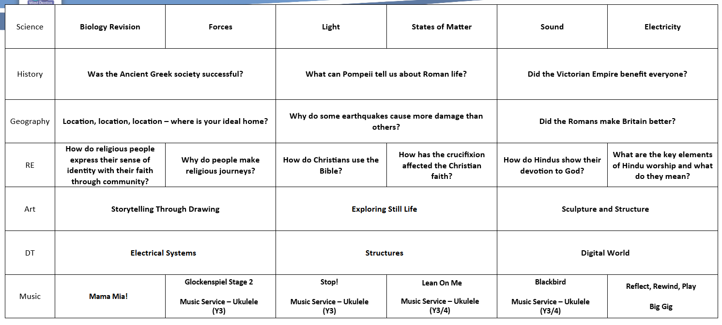

Slide 15
Basic Skills to Support your child
All children MUST be fluent in their times tables by the end of year 4.
They need to have quick recall of all multiplication facts ready for the MTC statutory assessment in June.
These need to be practised at home!

Slide 16
Helping your child reach their full potential
Talk to us if you have any concerns
Ensure your child is in school every day and on time
Listen to your child read daily or ensure they read daily independently
Ensure they bring their reading book into school every day
Ensure homework is completed and handed in on time or completed on line

Slide 17
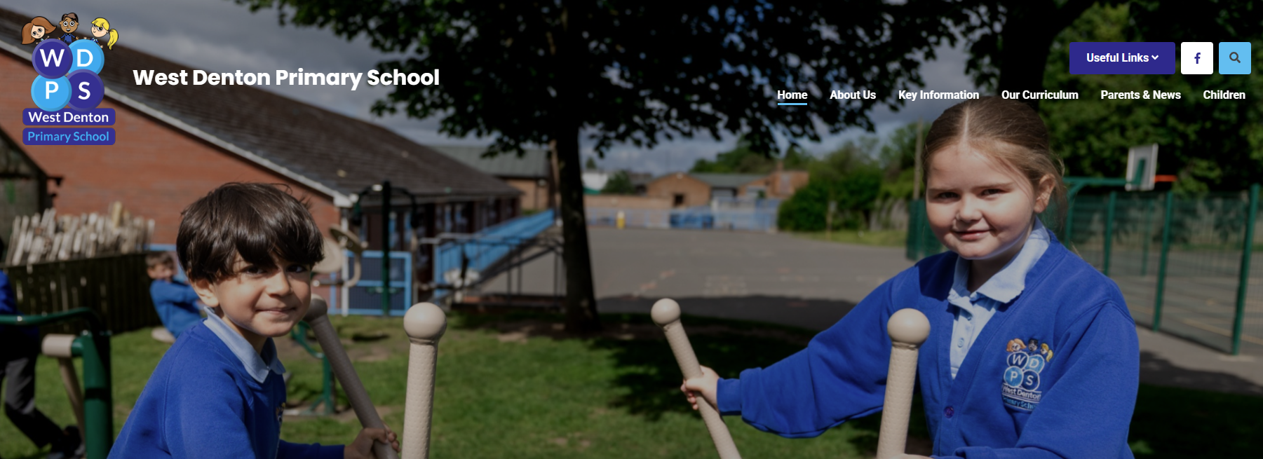
How to find out more
Our school website: New website ready to launch VERY soon!

Slide 18
If you need to talk to us…
We can pass on small pieces of information at the beginning of the day.
If you would like to talk more in-depth, please make an appointment with the office. We’re here to listen and address things as soon as possible.

