Slide 1

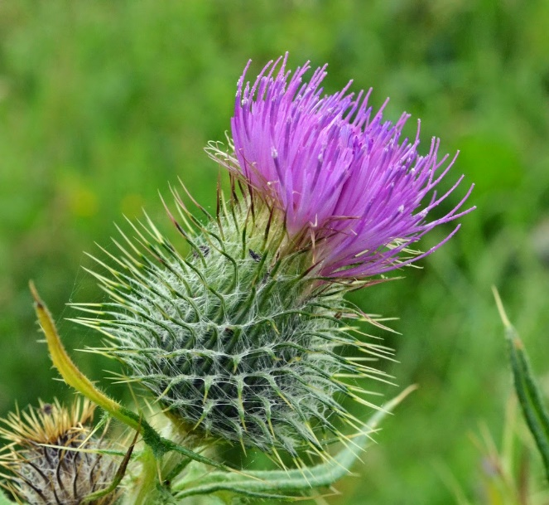
Welcome to Thistles

Slide 2

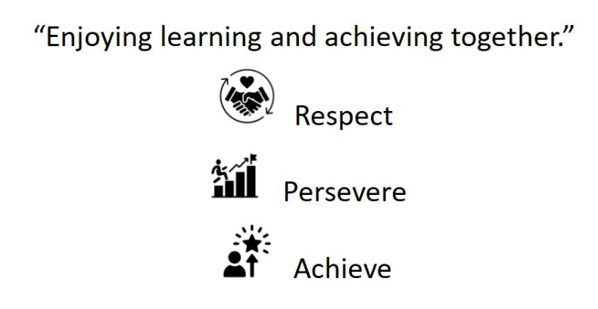
Our vision and Values:

Slide 3

School rules
Keep hands, feet and objects to ourselves
Use quiet calm voices
Always follow teacher instructions
Care for the school environment

Slide 4
Attendance and punctuality
School begins at 8.45am for all children
Breakfast clubs runs from 7.30am if needed
Children should be at school every day and on time
Good attendance and punctuality sets good habits for the future

Slide 5
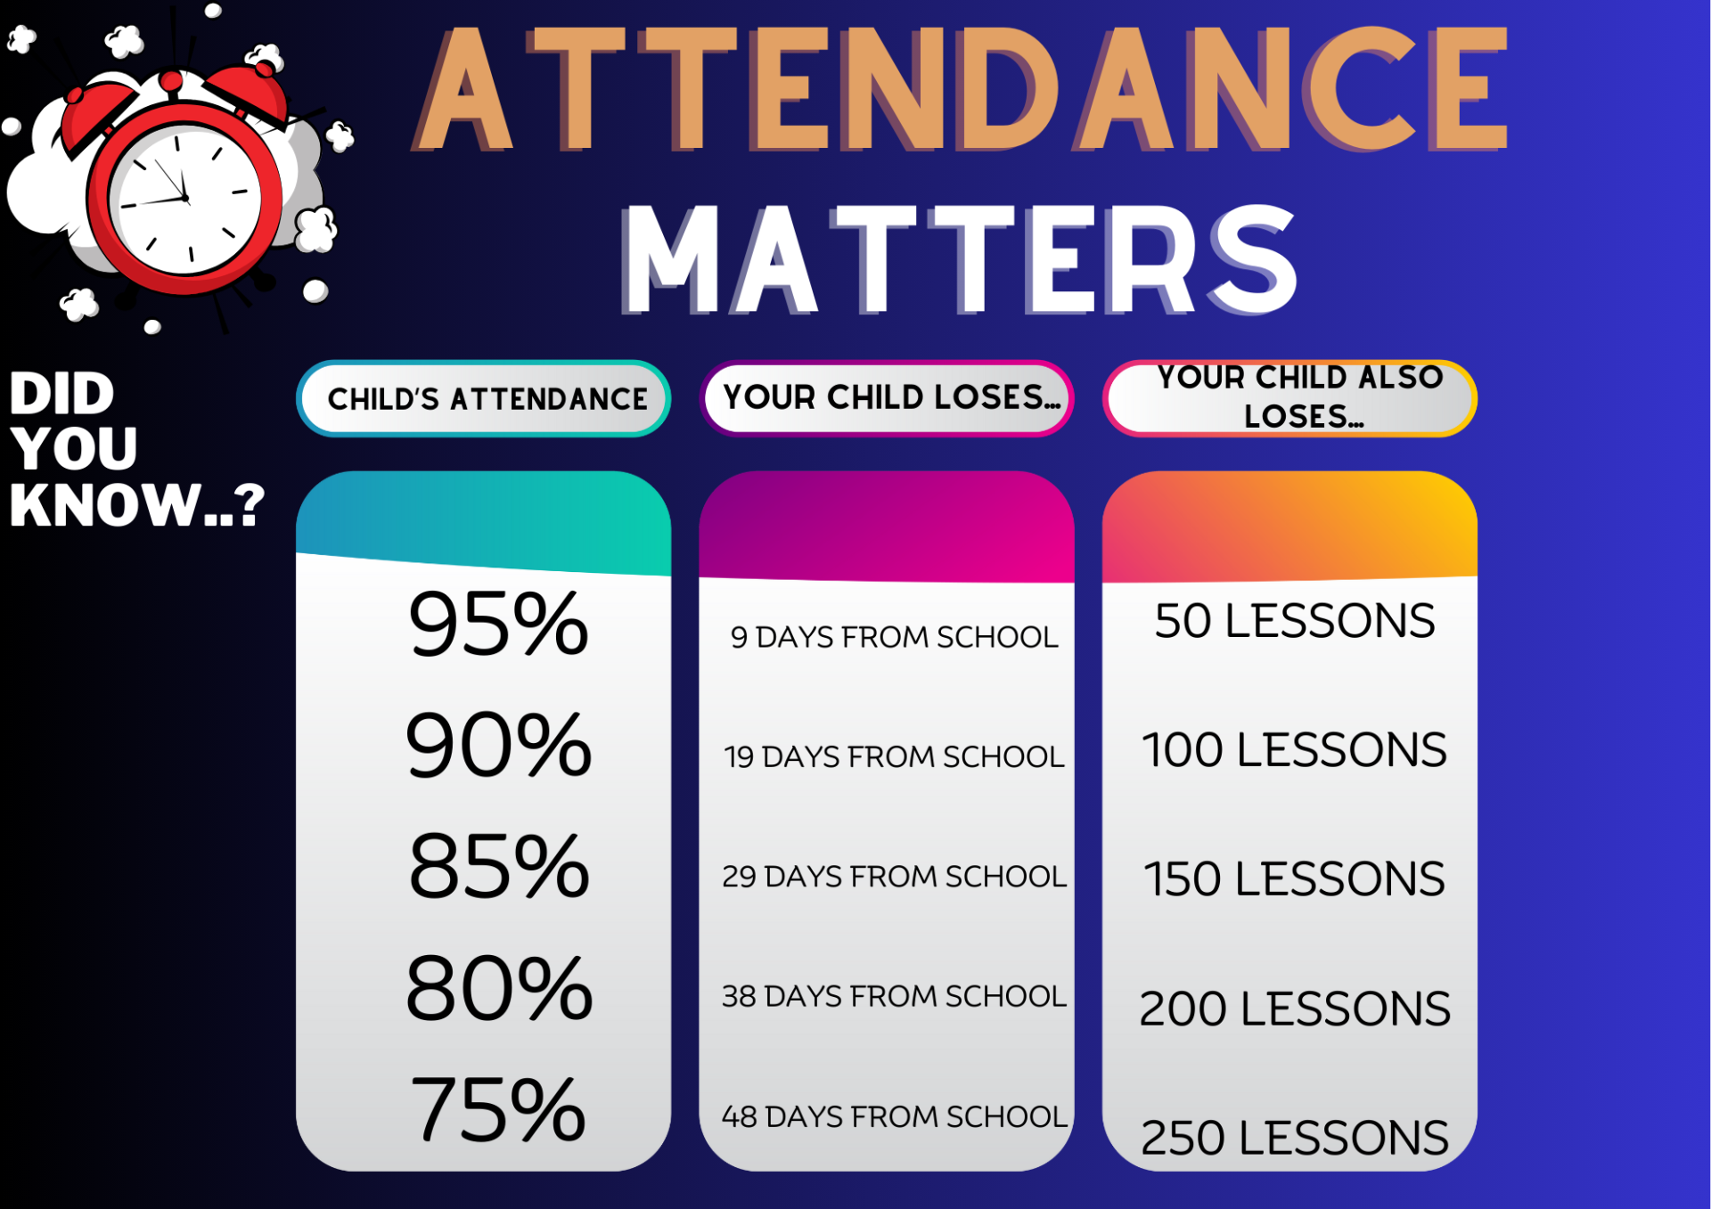

Slide 6
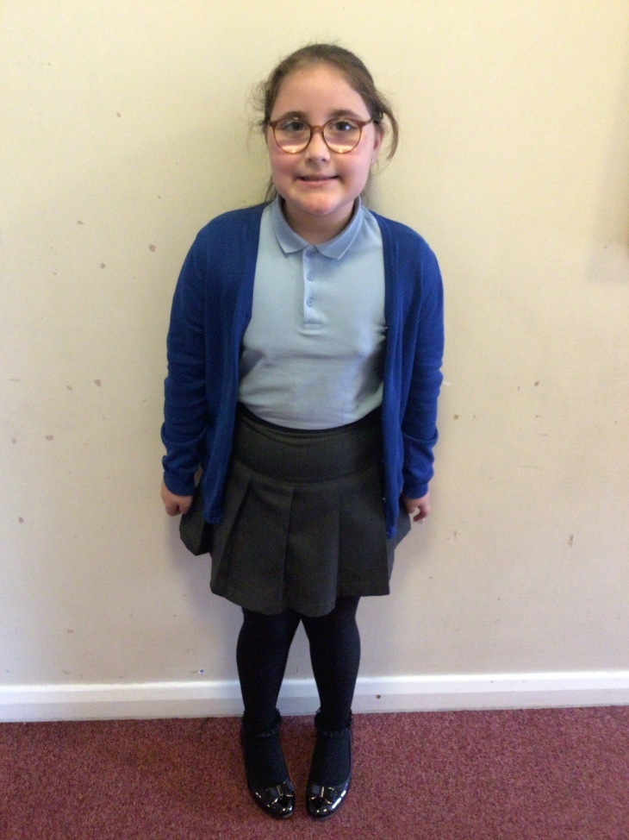
Uniform
Smart school uniform sets the tone for a day of learning.
Remember all black school shoes, stud earrings (if pierced), no extreme hair styles or hair coloured.
No false or acrylic nails (these are dangerous)
No make-up.

Slide 7
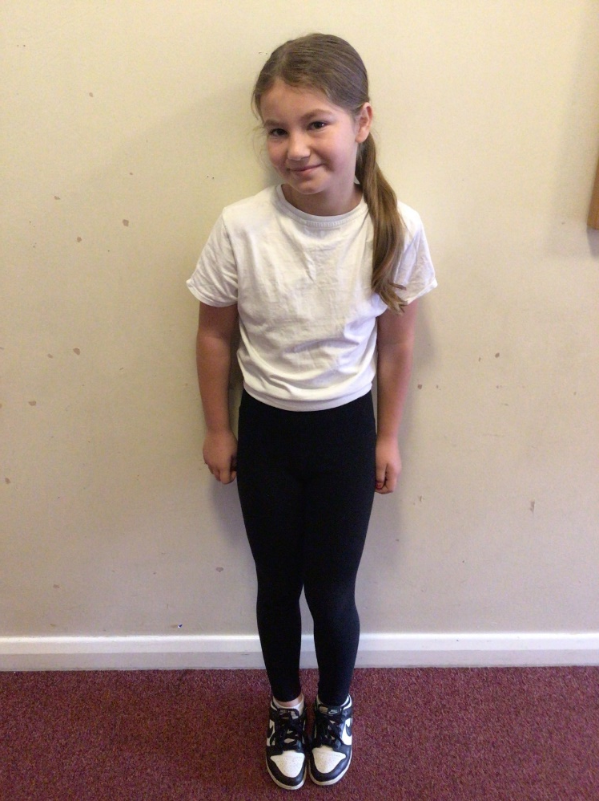
PE – Physical education
PE is part of the National Curriculum.
Our PE days are Tuesday and Thursday
Children are to come in their plain white PE tops or school polo-shirt for the day.
Children can wear plain black tracksuit bottoms/ leggings and school jumpers if it is cold. Usually shorts. Trainers must be worn.
Other clothing is not allowed.
(Swimming kit and days / costs as necessary)

Slide 8



#WDPSYearofReading
WE ARE A READING SCHOOL!
Our ambition is for every child to read by 7 using a synthetic phonics approach and to develop a love of reading for fluency and comprehension in order to access a broad and balanced curriculum. We do everything to make this happen.

Slide 9
Accelerated reader – a love of reading
What is Accelerated Reader?
Accelerated Reader is a computer program that helps teachers manage and monitor children’s independent reading practice. Your child picks a book at their own level and reads it at their own pace. When finished, your child takes a short quiz on the computer. (Passing the quiz is an indication that your child understood what was read.)
Accelerated Reader gives children and teachers feedback based on the quiz results, which the teacher then uses to help your child set goals and direct ongoing reading practice

Slide 10
homework
Homework in Upper KS2 consists of:
  Daily reading
  Spelling
  Maths and SPAG, with Fast 16
  It is set on a Friday and ‘collected’ on a Friday.
  This sets good habits for moving on in education and the world of work.
  It is tightly focused on core learning – it helps to build perseverance.
  Teachers will keep a record of children who complete homework.
  Children who do not complete their homework will be expected to do it during their lunch break on a Monday.

Slide 11
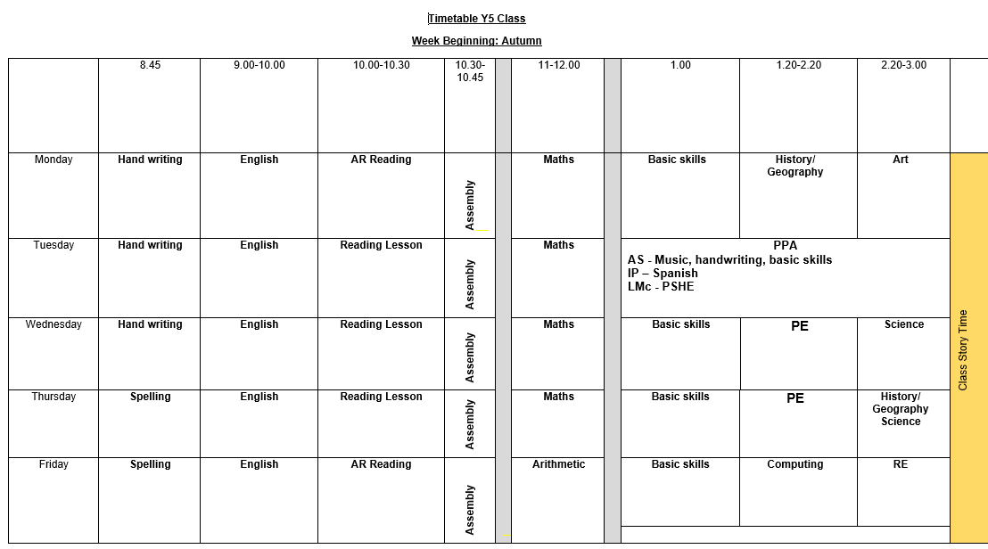
Class Timetable

Slide 12
Robinwood & London
The RobinWood residential dates are Monday 16th Nov-Wednesday 18th Nov.
London residential dates are Monday 15th March – Wednesday 17th March.
More information will follow about each of these nearer the time☺

Slide 13
Helping your child reach their full potential
Talk to us if you have any concerns
Ensure your child is in school every day and on time
Listen to your child read daily or ensure they read daily independently
Ensure they bring their reading book into school every day
Ensure homework is completed and handed in on time or completed on line

Slide 14
Basic Skills to Support your child
All children MUST be fluent in their times tables.
They need to have quick recall of all multiplication facts.
Number bonds to 10, 20 and 100 are also essential.
These need to be practised at home!

Slide 15
Staying safe online
Every month we publish a staying safe online document, which is aimed at parents.
This is to help inform them of current issues around computing and have more knowledge on what children are potentially doing online.
Please take time to read it

Slide 16
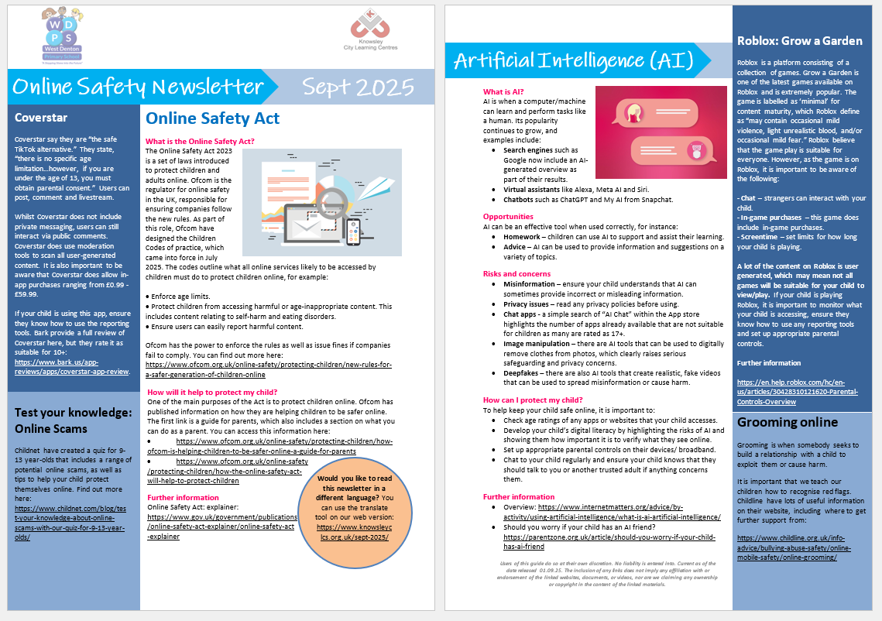
Staying safe online

Slide 17
If you need to talk to us…
We can pass on small pieces of information at the beginning of the day.
If you would like to talk more in-depth, please make an appointment with the office. We’re here to listen and address things as soon as possible.

Slide 18
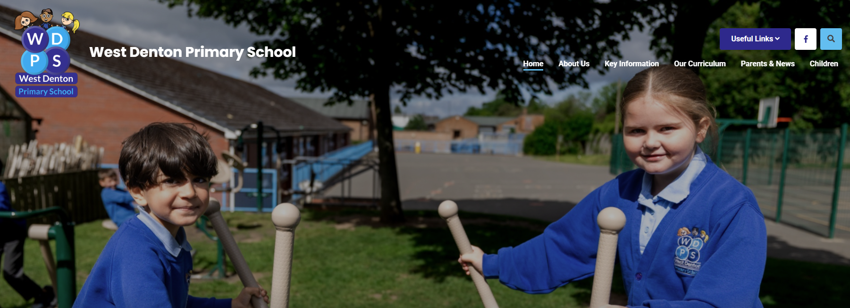
How to find out more
Our school website: New website ready to launch VERY soon!

