Slide 1


Welcome to the FORGET-ME-NOT Class

Slide 2
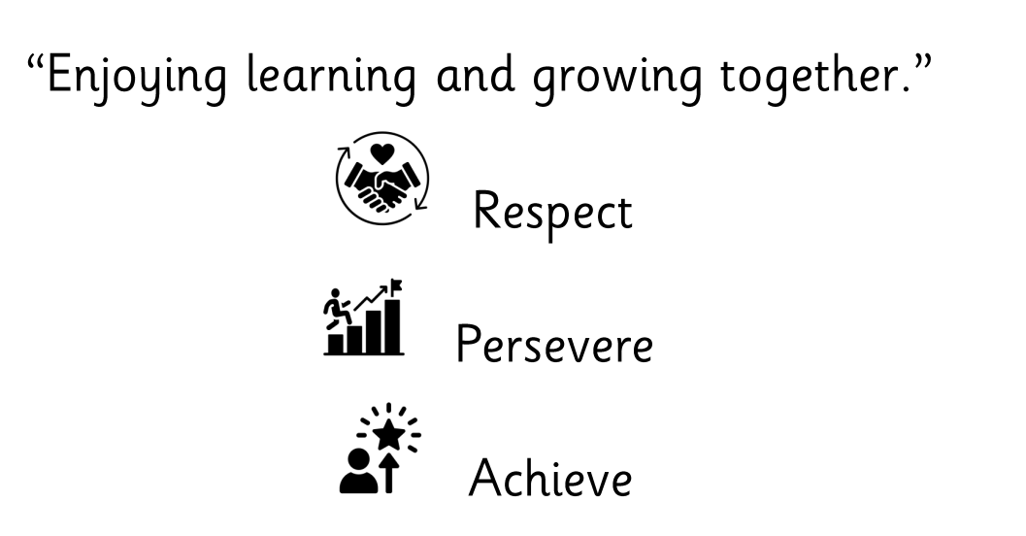
values

Slide 3
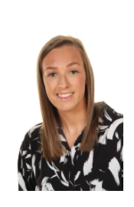
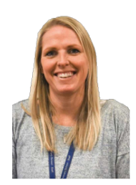
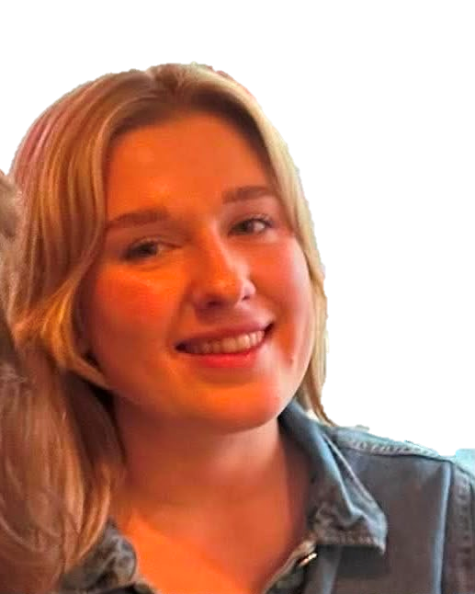
Dream team
Mrs Gracie
Miss Richardson
Miss Hogarth
Afternoon Support
Morning Support
Class Teacher

Slide 4
School rules
Keep hands, feet and objects to ourselves
Use quiet calm voices
Always follow teacher instructions
Care for the school environment

Slide 5
Attendance and punctuality
School begins at 8.45am for all children
Breakfast clubs runs from 7.30am if needed
Children should be at school every day and on time
Good attendance and punctuality sets good habits for the future

Slide 6
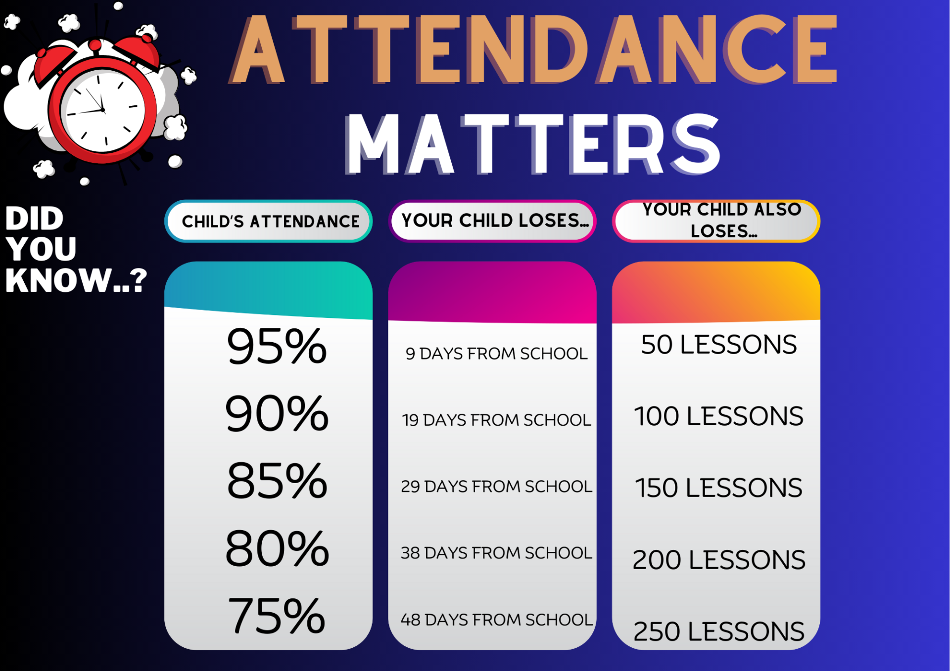

Slide 7




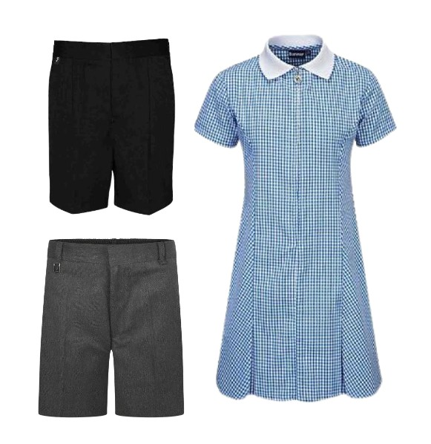

Uniform
Smart uniform sets the tone for a day of learning.
Remember school shoes, stud earrings (if pierced) and smart, natural hairstyles.
No squishies - health and safety

Slide 8

PE – Physical education
PE is part of the National Curriculum.
Our PE days are Wednesday and Friday.
Children are to come in their PE tops or school T-shirt for the day.
Children can wear black tracksuit bottoms and school jumpers if it is cold. Usually shorts.
Other clothing is not allowed.

Slide 9


Reading
Reading is one of the most important skills your child will develop, as it is the key to accessing learning across the whole curriculum.
Reading regularly builds confidence, vocabulary, comprehension and independence, helping children to become successful learners.
Please encourage your child to read for 10 minutes each night and remember to sign their reading record.

Slide 10

Accelerated reader – a love of reading
What is Accelerated Reader?
Accelerated Reader is a computer program that helps teachers manage and monitor children’s independent reading practice. Your child picks a book at their own level and reads it at their own pace. When finished, your child takes a short quiz on the computer. (Passing the quiz is an indication that your child understood what was read.)
Accelerated Reader gives children and teachers feedback based on the quiz results, which the teacher then uses to help your child set goals and direct ongoing reading practice

Slide 11


homework
Each week your child will be expected to complete a combined 30 minutes of TTRS and Accelerated Reader alongside revising weekly spellings using EdShed with your child’s individual password.
To prepare for secondary school, in Year 6, children are expected to complete their Fast 5 on three evenings across the week. This consists of 5 maths or grammar questions to complete at home and bring into school ready to mark the next morning. If your child is struggling with a question, please encourage them to attempt it and not worry as we will work through the answers together in class. We will start this next week!
On Mondays, children will take home a Let’s Talk Tuesday to answer in their reading records for the next morning. We encourage children to share this with you at home. We will also start this next week!

Slide 12
SATS
Key Stage 2 (KS2) SATs week for 2027 will run from Monday 10th to Thursday 13th May 2027.
Monday – Grammar and Spelling
Tuesday – Reading
Wednesday – Arithmetic and Reasoning 1
Thursday – Reasoning 2
Friday – Celebration Day!!

Slide 13
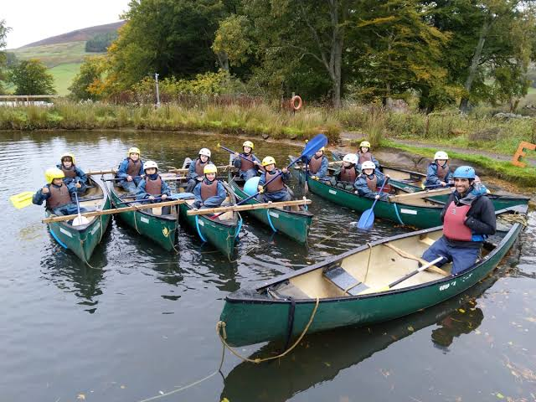

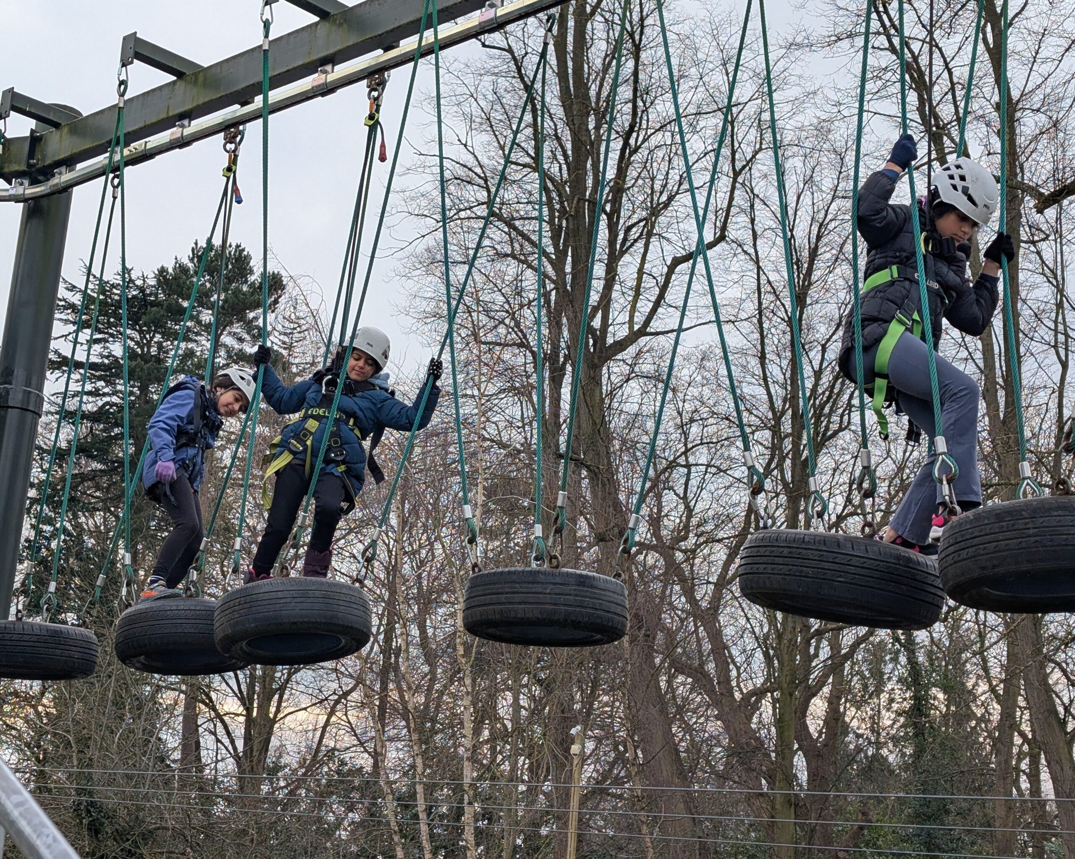
Robinwood
16th to 18th November 2026

Slide 14

How to find out more
Our school website: New website is live!

Slide 15
If you need to talk to us…
We can pass on small pieces of information at the beginning of the day.
If you would like to talk more in-depth, please make an appointment with the office. We’re here to listen and address things as soon as possible.

